Slide 1
DATA STRUCTURES

Slide 2
WHY DO WE NEED DATA STRUCTURES?

Slide 3
As applications are becoming more complex and the amount of data is increasing day by day, which may cause problems with processing speed, searching data, handling multiple requests etc. Data structure provides a way of organizing, managing, and storing data efficiently.
With the help of data structure, the data items can be traversed easily.
Data structure provides efficiency, reusability and abstraction.
It plays an important role in enhancing the performance of a program because the main function of the program is to store and retrieve the user’s data as fast as possible.

Slide 4
WHAT IS DATA STRUCTURE?

Slide 5
A data structure is a collection of data values and the relationships between them.
Data Structures allows programs to store and process data effectively.
There are many different data structures, each with its own advantages and disadvantages. Some of the most common data structures are arrays, lists, trees and graphs.

Slide 6
WHY LEARN DATA STRUCTURE

Slide 7
Data structure and algorithms are two of the most important aspects of computer science.
Data structures allow us to organize and store data, while algorithms allow us to process that data in a meaningful way.
Learning data structure and algorithms will help you become a better programmer.
You will be able to write code that is more efficient and more reliable.
You will also be able to solve problems more quickly and more effectively.

Slide 8
TYPES OF DATA STRUCTURE

Slide 9
2 types of data structure:
Primitive
Non-Primitive

Slide 10
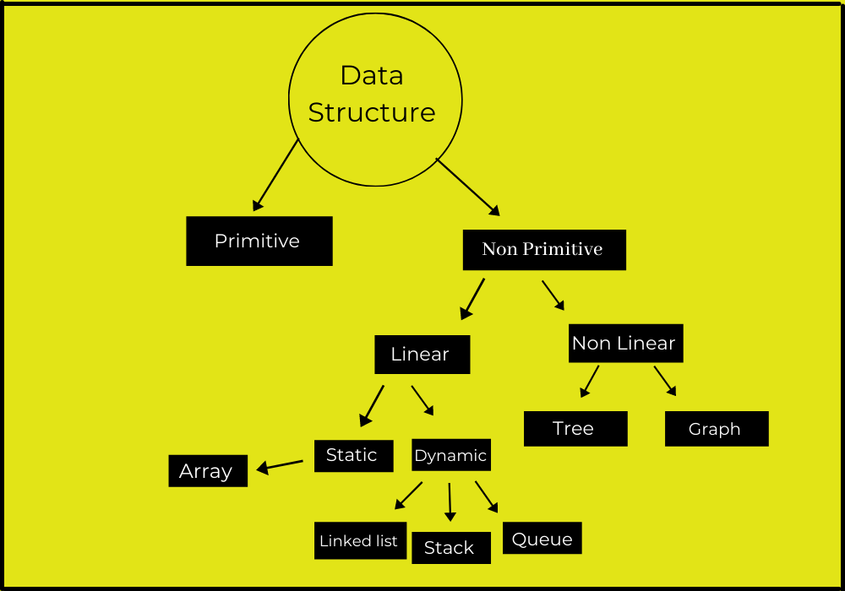

Slide 11
Primitive Data Structure –
Primitive Data Structures directly operate according to the machine instructions. These are the primitive data types. Data types like int, char, float, double, and pointer are primitive data structures that can hold a single value.

Slide 12
Non – Primitive Data Structure –
Non-primitive data structures are complex data structures that are derived from primitive data structures. Non – Primitive data types are further divided into two categories.
Linear Data Structure
Non – Linear Data Structure

Slide 13
Linear Data Structure –
Linear Data Structure consists of data elements arranged in a sequential manner where every element is connected to its previous and next elements.
This connection helps to traverse a linear arrangement in a single level and in a single run.
Such data structures are easy to implement as memory is additionally sequential. Some examples of Linear Data Structure are List, Queue, Stack, Array etc.

Slide 14
Types of Linear Data Structure –
1] Arrays –
An array is a collection of similar data elements stored at contiguous memory locations. It is the simplest data structure where each data element can be accessed directly by only using its index number.

Slide 15
2] Linked List –
A linked list is a linear data structure that is used to maintain a list-like structure in the computer memory. It is a group of nodes that are not stored at contiguous locations. Each node of the list is linked to its adjacent node with the help of pointers.

Slide 16
3] Stack –
Stack is a linear data structure that follows a specific order during which the operations are performed. The order could be FILO (First In Last Out) or LIFO (Last In First Out).
The basic operations performed in stack are as follows :
Push – Adds an item within the stack.
Pop – Deletes or removes an item from the stack.
Top – Returns the topmost element of the stack.
IsEmpty – Returns true if the stack is empty.

Slide 17
4] Queue –
Queue is a linear data structure in which elements can be inserted from only one end which is known as rear and deleted from another end known as front. It follows the FIFO (First In First Out) order.
Enqueue – Adds an element to the queue.
Dequeue – Deletes or removes an element from the queue.
IsFull – Returns true if the queue is full.
IsEmpty – Returns true if the queue is empty.

Slide 18
l = [1,2,3,4,5]
L[-1], l[4]

